Slide 1
Synthetic Medical imaging with diffusion model
Vedansh dixit

Slide 2
Objective of Study
Develop a conditional diffusion model specifically optimized for chest X-ray synthesis for Pneumothorax and Pneumonia.
Creating a deployable system using Hugging Face Spaces that allows clinicians to generate specific X-ray views or pathologies through a web interface

Slide 3
Why diffusion-model based generation ?
While GANs (Generative Adversarial Networks) pioneered high-resolution synthesis, their adversarial training often produces artifacts in subtle anatomical regions and suffer from training instability .
Variational Autoencoders (VAEs) offer more stable training but tend to generate blurry outputs unsuitable for diagnostic applications.
Diffusion models overcome these limitations through their progressive denoising approach, particularly effective for preserving fine details in X-rays.

Slide 4
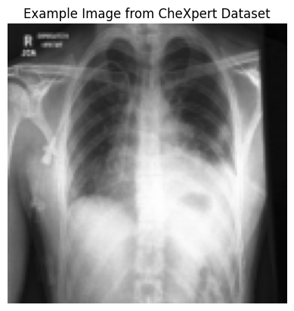
DATA SOURCE:
CheXpert dataset From Stanford Hospital
Large sample size across diverse demographics
Expert radiologist annotations
Standardized DICOM preprocessing.

Slide 5
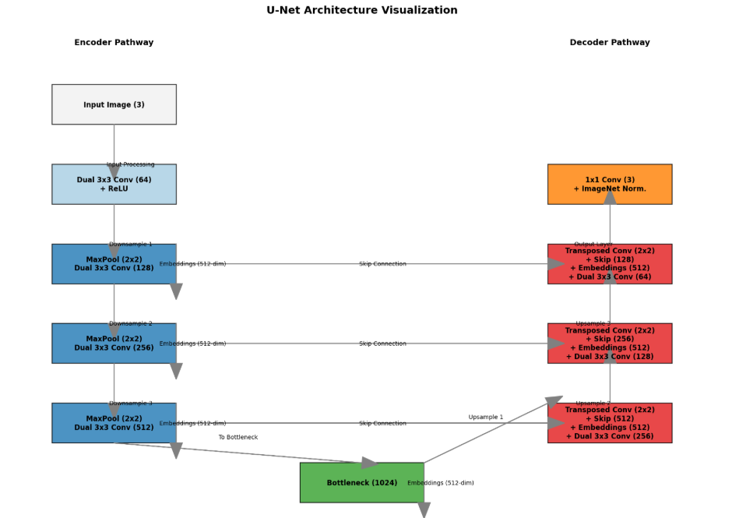
MODEL ARCHITECTURE

Slide 6
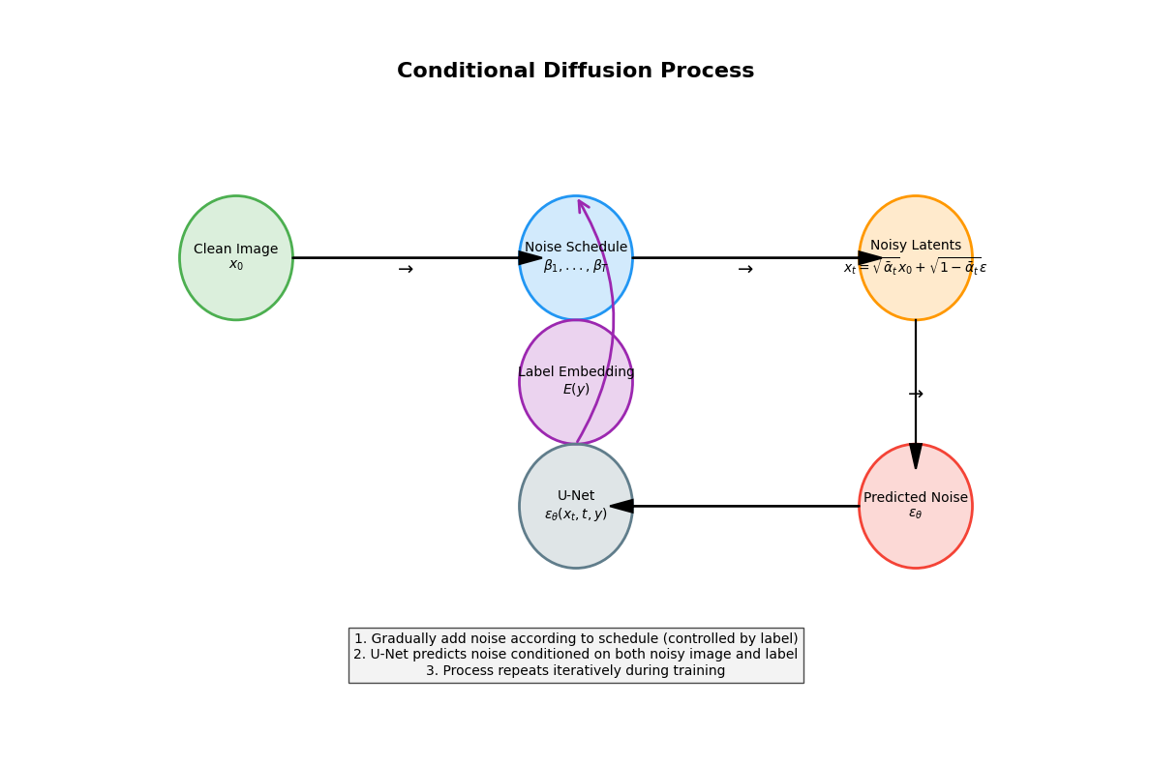

Slide 7
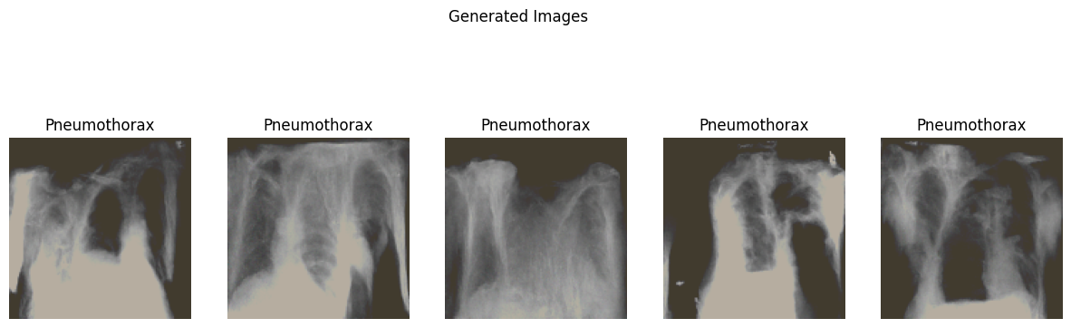
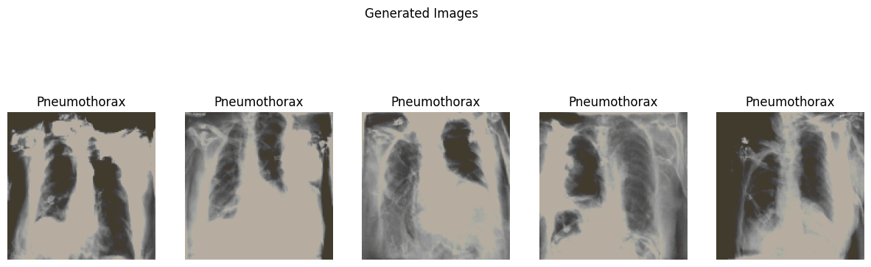
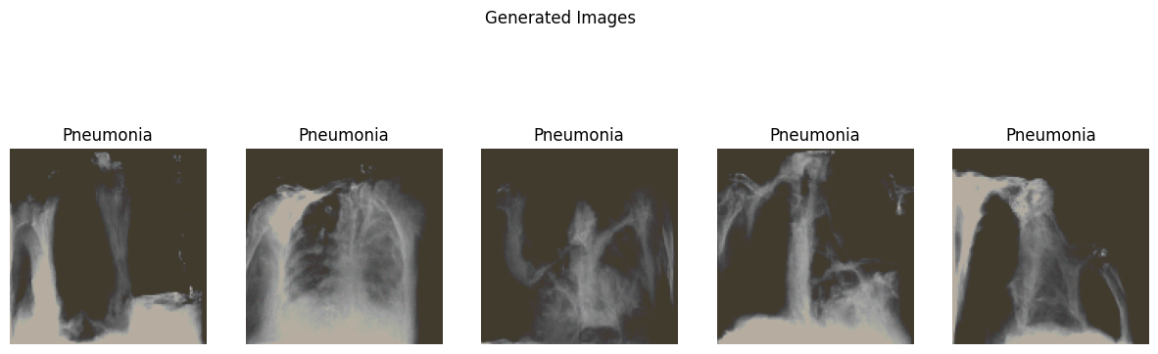
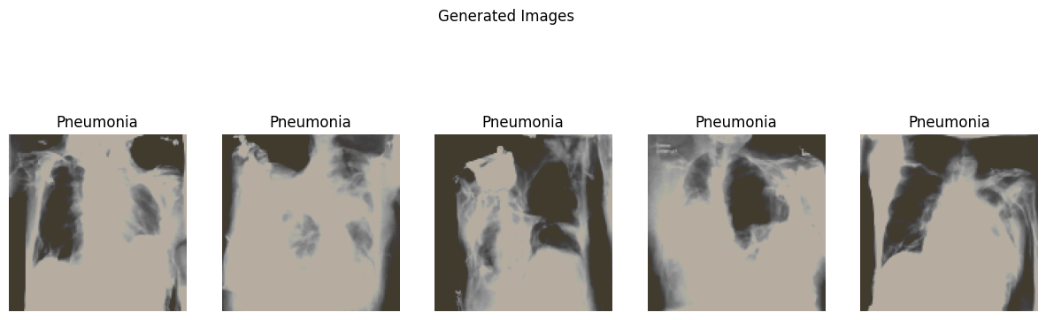
RESULTS DURING TRAINING
AT 35 EPOCHS
AT 50 EPOCHS

Slide 8
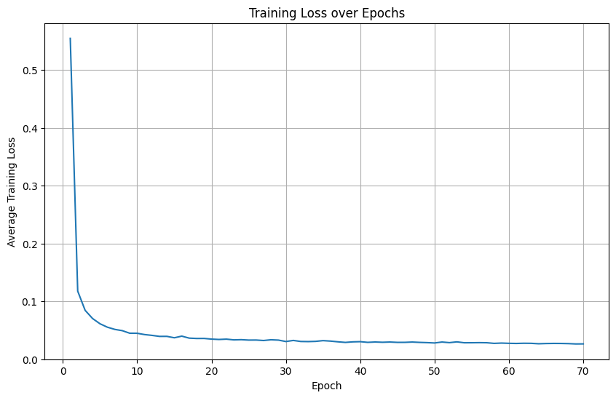
TRAINING LOSS VS EPOCHS

Slide 9
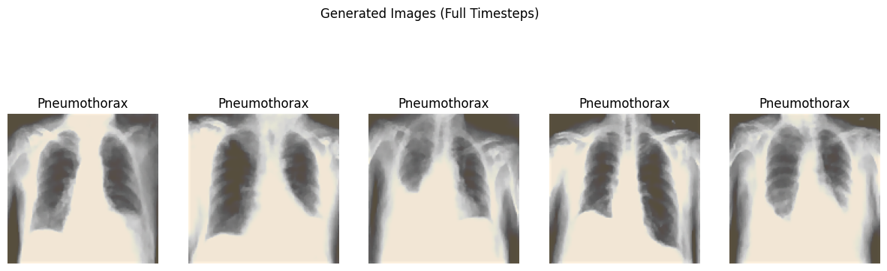
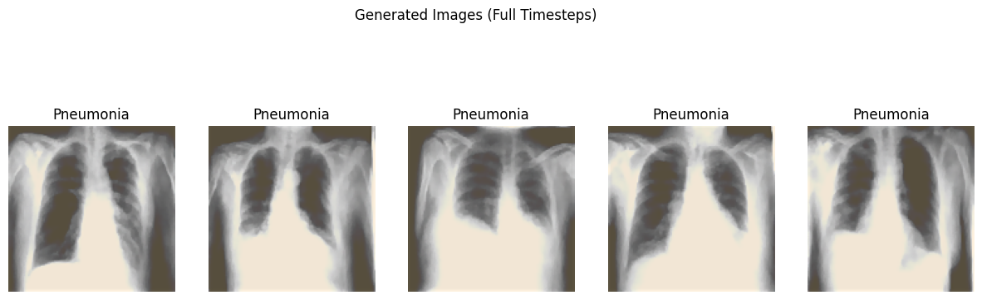
FINAL RESULTS
AFTER 70 EPOCHS

Slide 10
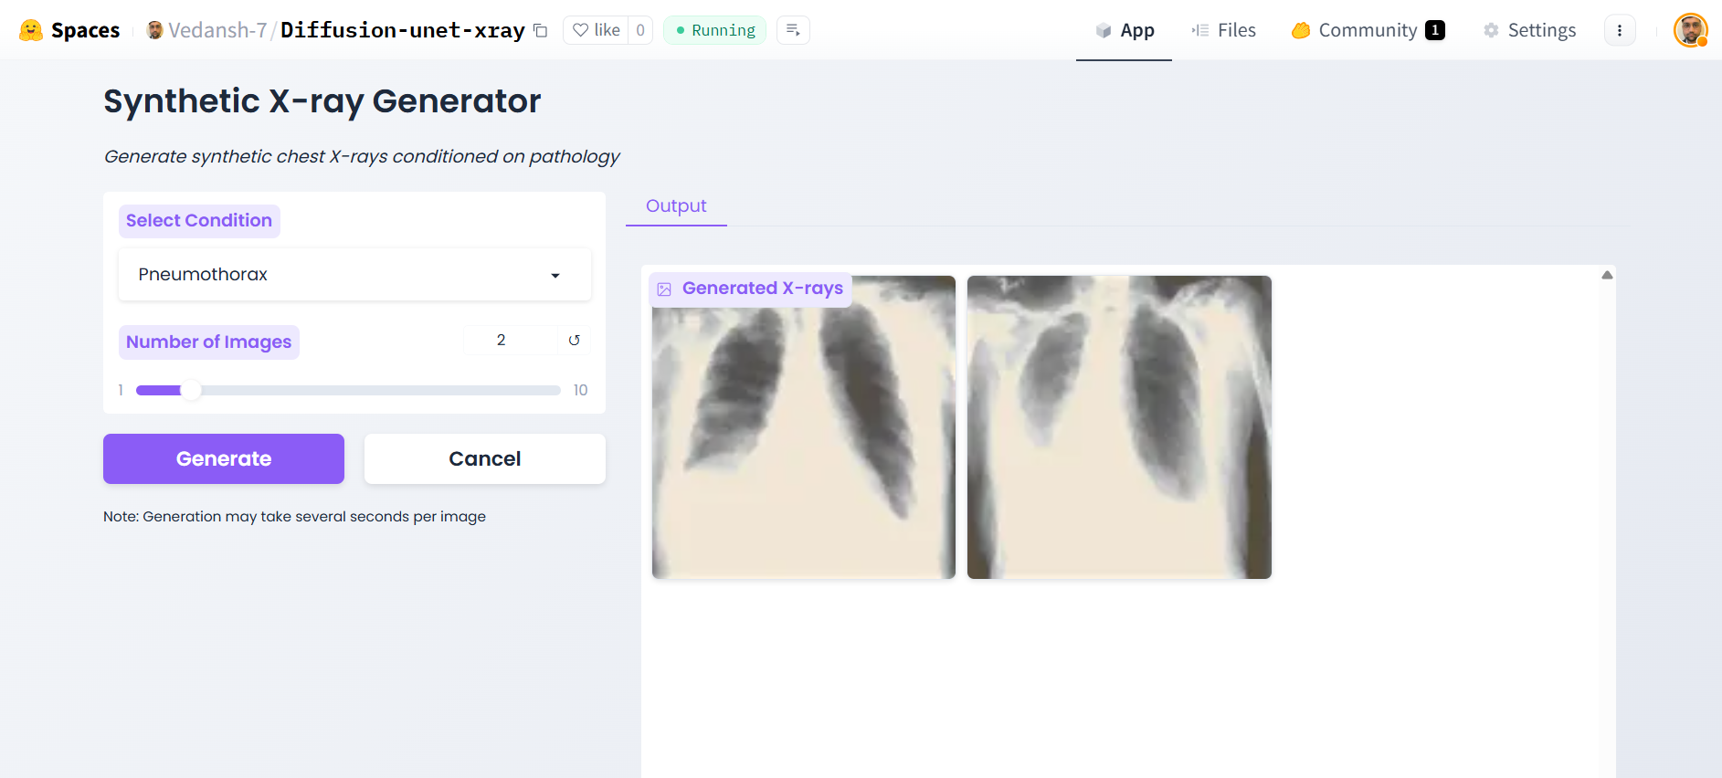
DEPLOYMENT RESULTS

Slide 11
Scope of improvement
During training image size as 256 and batch size as 128 could significantly improve the quality of images but due to limited size of GPU T4 on google colab (16 GB ) we can’t implement it.
While deploying we could significantly improve the speed of image generation by using Pro tier of Huggingface that includes GPU for image generation.

Slide 12

Thank you

